Slide 1
High Performance and Distributed Computing for Big Data
Unit 3: Cloud Systems and Big Data Management
Session 6 & 7 - AWS Networking
Francesc Solsona francesc.solsona@udl.cat
Universitat Rovira i Virgili and Universitat de Lleida

Slide 2
Recap

Slide 3
Networking concepts we already met
Throughout the course, we have already been interacting with different networking concepts. Here are some of them:
We have been connecting to EC2 instances using SSH.
We have been using the public IP address of the EC2 instances.
We have been using the DNS name of the EC2 instances.
We have been using different ports to launch different services

Slide 4
Networking concepts we already met
Although we have been working with these concepts, we haven’t really discussed them in detail. Here are some questions that we can ask ourselves:
Why do we sometimes specify which port to use when connecting to a service?
Why do we use the public IP address of an EC2 instance instead of the private IP address?
Why can we use the DNS name and the public IP address interchangeably?
What is the difference between a public and a private IP address?
Why is the IP address changing every time we restart the lab?

Slide 5
Networking basics

Slide 6
What is an IP address?
An IP address is a unique identifier for a device. The same way a street address identifies a house, an IP address identifies a device on a network.
An IP address is a 32-bit number that is divided into four 8-bit numbers separated by dots. For example, 1.2.3.4 or 52.4.75.36 .
Every one of these 8-bit numbers is called an octet and can have a value between 0 and 255.
All IP addresses in the world have a value between 0.0.0.0 and 255.255.255.255 which makes up a total of 4,294,967,296 possible IP addresses (2^32).
So we have around four billion IP addresses. This might seem like a lot, but it is not enough to give an IP address to every device in the world.

Slide 7
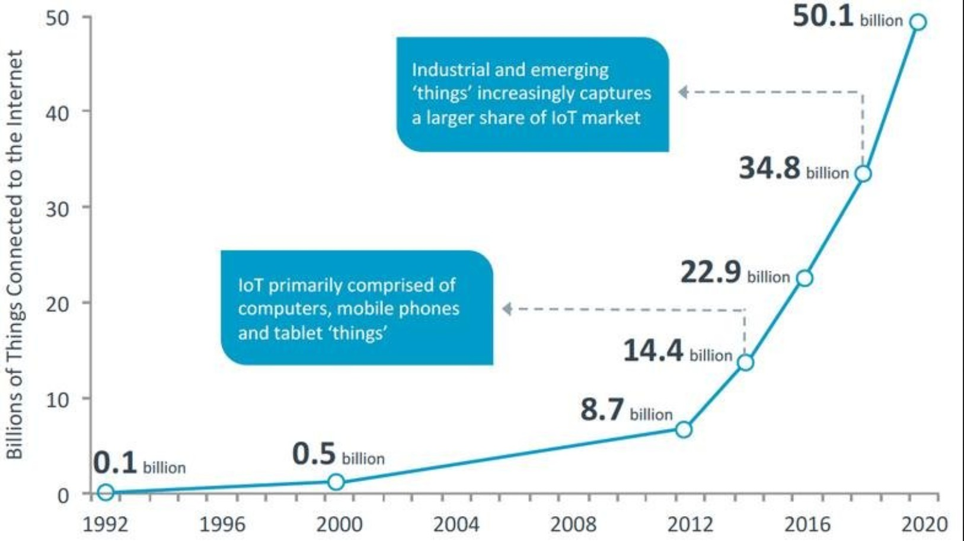
What is an IP address?
How do we solve this? Any idea?

Slide 8
Private vs Public IP addresses
To solve the problem of not having enough IP addresses, we use private and public IP addresses.
Private IP addresses are used to identify devices within a network. They are not unique and can be reused in different networks.
Public IP addresses are used to identify devices on the internet. They are unique and can’t be reused.
Address Ranges are reserved for private and public IP addresses. IPs that fall into
10.x.x.x, 172.16.x.x - 172.31.x.x, 192.168.x.x are reserved for private IP addresses.

Slide 9
Private vs Public IP addresses
Think of it as a hotel. The room number is the private IP address and the hotel street address is the
public IP address.
The room number is unique within the hotel, but not unique across all hotels.
The hotel street address is unique and can’t be reused.
The hotel street address is used to identify the hotel from the outside world, while the room number is used to identify the room within the hotel.

Slide 10
The Domain Name System (DNS) is a system that translates domain names to IP addresses. Remember during class when I said you can use the DNS name or the public IP address to connect to an EC2 instance? A DNS name or a domain name is a human-readable name that references an IP address.
DNS
If we go back to the hotel analogy, the hotel name is the DNS name and the hotel street address is the public IP address.
To know to which IP address a domain name corresponds, we use a DNS server. This server is like a phone book that translates domain names to IP addresses.

Slide 11
Ports
Once we know the address of a device, whether we already knew the IP address or the DNS name, we need to know which service we want to connect to. So imagine the EC2 machine we configured with jupyter notebook. That machine has at least two services running: the SSH service (port 22) and the Jupyter notebook service (we used port 8888).
When we connect to the EC2 machine through SSH, we don’t need to specify the port because the default port for SSH is 22, but we could if we wanted.
$ ssh -i ~/.ssh/aws-keypair ec2-user@<your-ec2-instance-public-ip> -p 22
The above command will work the same as if we didn’t specify the port. But notice that if we specify a different port:
$ ssh -i ~/.ssh/aws-keypair ec2-user@<your-ec2-instance-public-ip> -p 1234
We get an error:
ssh: connect to host <your-ec2-instance-public-ip> port 1234: Connection timed out

Slide 12
Ports
What did we do to access te jupyter notebook service? We used the public IP address of the EC2 instance (or the DNS name) and the port 8888. But instead of using the SSH command, we typed the following in the browser:
http://<your-ec2-instance-public-ip>:8888
That is because for SSH, we use the ssh command and point to a specific IP address (or the DNS name) and port. But for jupyter notebooks, we use the browser and point to a specific IP address and port.
In both cases we are accessing a service on a remote device.

Slide 13
Recap
We’ve seen how IP addresses are used to identify devices, and how there’s private and public IP addresses that are used to identify devices within a network and on the internet respectively. Some questions to think about:
How do multiple devices in a network share a single public IP address?
What even is a network?
How do we manage the IP addresses in a network? How do we choose which devices get which IP addresses?
Let’s explore these questions further starting with a situation you may be familiar with: your home network.

Slide 14
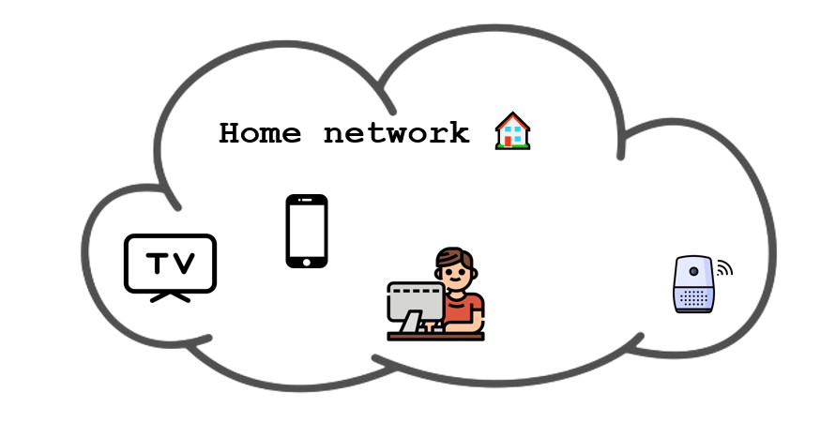
Our home network
Let’s imagine a simple home network where we have some devices connected. So for example we could have the computer we are using right now, a phone, a smart TV and a smart speaker (like an Amazon Echo).

Slide 15
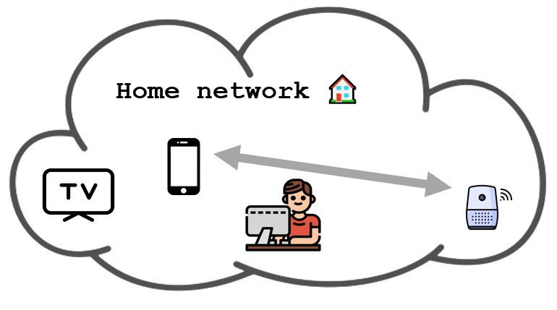
Our home network
The devices can talk between themselves. For example, when I am playing a song on spotify on my phone, I can send it to the smart speaker so my smart speaker is now playing the song.
But what is happening? Is my phone directly talking to my smart speaker?

Slide 16
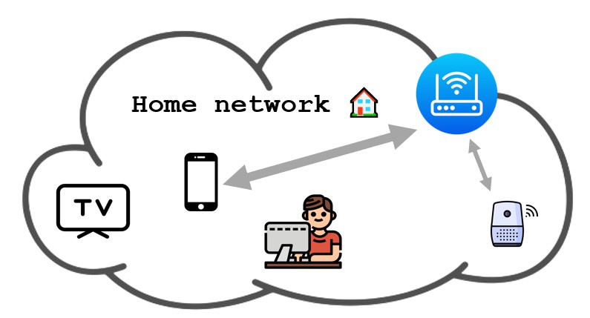
Your router and NAT
No! There is a key player and I am sure you have heard of it: the router. The device we must restart when the internet is not working.
The router is the receptionist of the network. It is the one responsible for routing traﬀic between devices in the network and between the network and the internet. So if my phone wants to talk to the smart speaker, it sends the message to the router and the router sends it to the smart speaker.

Slide 17
Your router and NAT
Remember we said there are different private IP ranges reserved for private networks? Well, the router uses these private IP addresses to identify the devices in the network. So when my phone sends a message to the smart speaker, it uses the private IP address of the smart speaker. The same way a hotel uses room numbers to identify rooms.
In fact, let’s do an experiment. Open a terminal and run the following command if you are on Windows:
Node> ipconfig
Or if you are on Linux or MacOS:
$ ifconfig

Slide 18
Your router and NAT
If you look for your IPv4 Address, you will see an address that fits into 192.168.x.x, 10.x.x.x or
172.16.x.x - 172.31.x.x. Most of the times on regular homes it will be 192.168.x.x. This is analogous to how different hotels will use the same room numbers (like room 101) that are not unique in the world.
If you instead visit a website like whatismyip.com, you will see a different IP address. This is the public IP address of your network. This is the address that identifies your network to the outside world.

Slide 19
Your router and NAT
Let’s see now how the router uses the public IP address to communicate with the internet.
Imagine you are staying in the hotel and want to send a letter to a friend’s home (and imagine the hotel is willing to send the letter for you). You would write the address of your friend’s home on the envelope, hand it to the receptionist, and the receptionist would send it to your friend’s home.
More people on the hotel may be sending letters to their respective friends’ homes, so the receptionist needs to keep track of which letter goes to which home so when the responses come back, the receptionist knows to whom to give the letter.

Slide 20
Your router and NAT
The router does the same thing. If your phone is streaming a YouTube video, and your smart TV is streaming a Netflix movie, the router is handling traﬀic between your phone and YouTube and between your smart TV and Netflix both through the same public IP address and the public IPs of YouTube and Netflix.
The router keeps track of which traﬀic is going where so when the responses come back, it knows to whom to send the response. In networking terms, this is called Network Address Translation (NAT) and is the protocol routers use to allow multiple devices with private IP addresses to share a single public IP address. Read more about NAT here.

Slide 21
What is a network?
So far we have been talking about networks, using private IPs to communicate between devices within the network and public IPs to communicate with the internet. But what is a network? And what is the internet?
A network is a collection of devices that are connected to each other. So in our home network example, the phone, the smart TV, the smart speaker, and the computer are all part of the network and they are identified by private IPs.
In the hotel analogy, the network is the hotel and the different devices are the rooms, where the room number would be the private IP address.

Slide 22
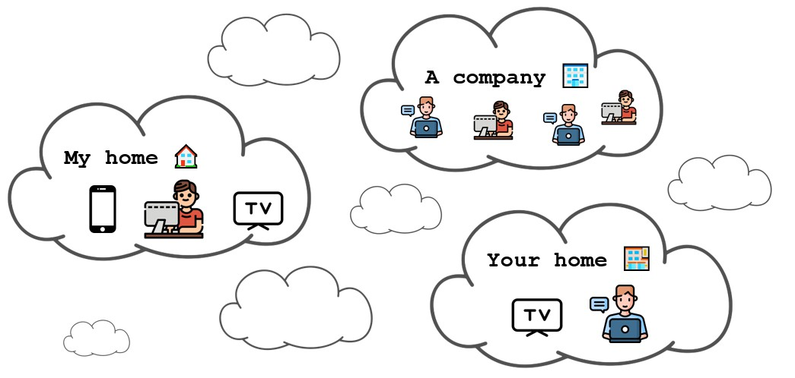
What is a network?
But our home network is not the only network in the world. There are many networks all over the world; your home network, a given company network, the network of a university, etc.

Slide 23
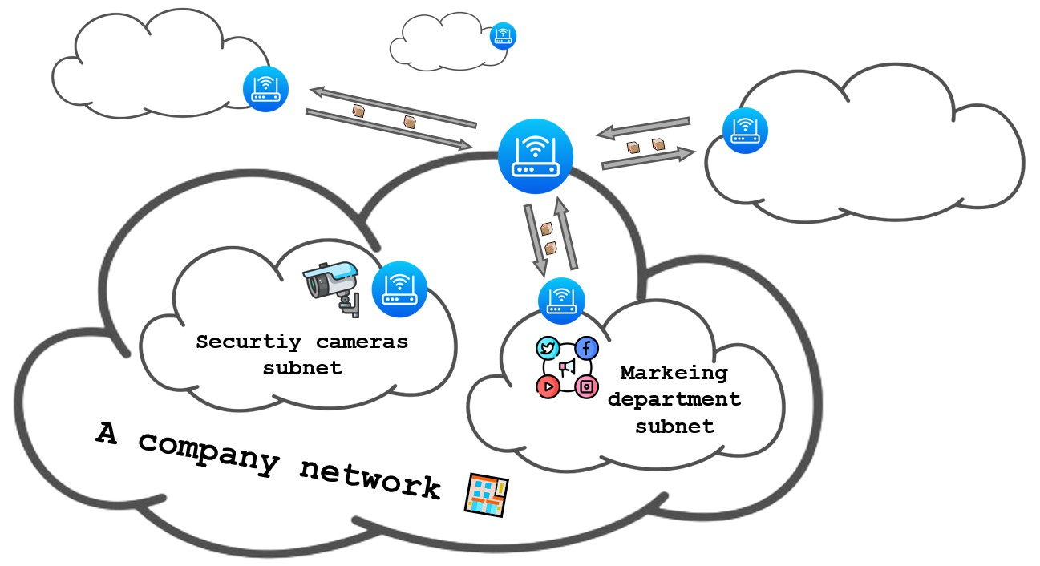
What is the internet?
Networks are hierarchical. So the network of a company can be made up of different networks, like the network of the sales department, the network of the marketing department, etc.

Slide 24
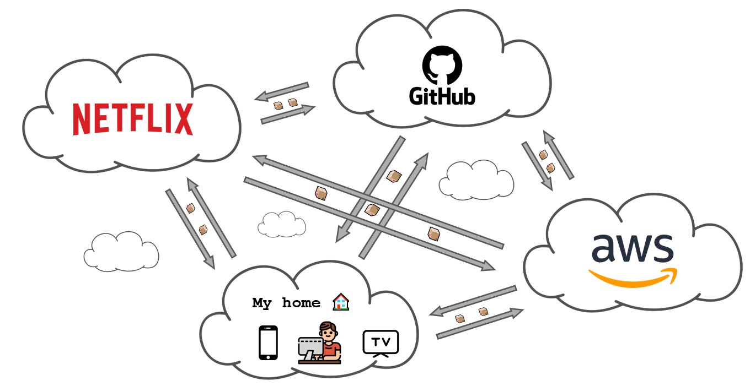
What is the internet?
Although private networks exist, the most common scenario is for networks to be connected to the rest of the world. In fact, the internet is nothing more than the biggest network of networks in the world.
That is why from our home network we can access anything available on the internet, like YouTube, Netflix, AWS or even this lecture. The whole picture would look like this:

Slide 25
What is the internet?
We constantly use concepts like the cloud or the internet without really thinking that this is just a colossal amount of devices connected between them.
When I want to connect to an EC2 machine in the cloud, (assuming it is on the default region
us-east-1 ), I am just sending electrical signals to a computer located in a datacenter in the United States.

Slide 26
What is the internet?
Think for a moment the insane trip that the electrical signals have to make to go from your computer to the EC2 machine. They will first go from my computer to my router, from my router at my home to a series of routers managed by Internet Service Providers (ISPs) in Spain, from there it has to cross the Atlantic Ocean to reach the United States, and then go through a series of routers managed by ISPs in the United States to finally reach the datacenter where the EC2 machine is located.
The internet is possible because of an immense infrastructure of cables, routers, switches, and servers that are all connected to each other. In fact, there are a huge amount of cables that go under the ocean to connect the different continents. You can see a map of these cables submarinecablemap.com.

Slide 27
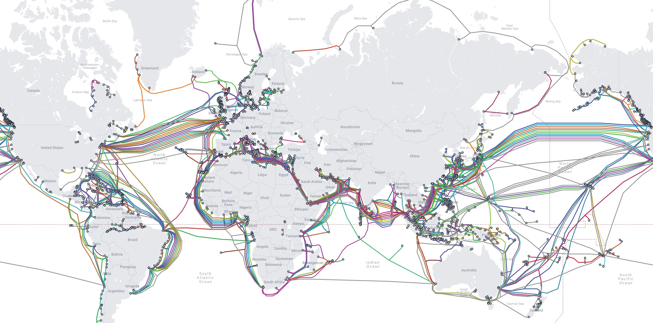
What is the internet?

Slide 28
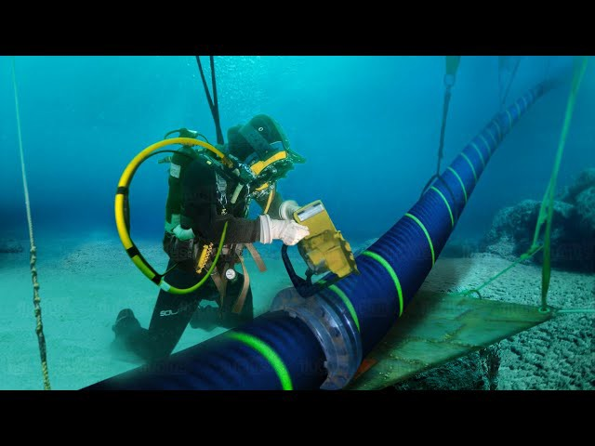
What is the internet?
Have you ever thought that when you are doing anything on the internet, you may be sending electrical signals that are crossing the ocean?

Slide 29
Playing with the internet
We can do a quick experiment to know how far the electrical signals have to travel to reach a given location. We can use the ping command to measure the time it takes for a signal to go from our computer to a given location and back.
$ ping google.es
The above command will send a signal to google.es and measure the time it takes for the signal to go and come back. The time it takes is called the round-trip time and is measured in milliseconds. The round-trip time is a good indicator of how far the location is from your computer. The bigger the round-trip time, the farther the location is.

Slide 30
Playing with the internet
To see how much time does it take for network traﬀic to reach different parts of the world, we can use domain names that we know are located in different countries. For example, we can use the following domains:
$ ping es.pool.ntp.org # Spain
$ ping us.pool.ntp.org # United States
$ ping ru.pool.ntp.org # Russia
$ ping nz.pool.ntp.org # New Zealand

Slide 31
Playing with the internet
Another command we can use to explore the internet is the tracert command (or traceroute for MacOS or Linux users). This command shows the path that the network traﬀic takes to reach a given location by printing the IP addresses of the routers that the traﬀic goes through.
$ tracert es.pool.ntp.org # Spain
$ tracert us.pool.ntp.org # United States
$ tracert ru.pool.ntp.org # Russia
$ tracert nz.pool.ntp.org # New Zealand

Slide 32
Recap
We’ve seen how a network is a collection of devices that are connected to each other and how the internet is the biggest network of networks in the world. Some questions to think about:
How can a single network be made up of multiple networks?
How does my router choose which IP address to give to the devices that get connected?
How does a router decide which traﬀic goes where and which subnet can talk to which other subnet?

Slide 33
Subnetting

Slide 34
What is a subnet?
While explaining what is the internet, we mentioned that a network can be made up of different networks.
This is where subnets come into play. A subnet is a way of dividing a network into smaller networks.
The subnets allow us to divide a network into smaller networks and control which subnet can talk to which other subnet.
In the case of a company we may want the subnet of sales department and the subnet of the marketing department to be able to talk to the subnet of IT administration, but we don’t want the subnet of sales to be able to talk to the subnet of marketing.
We could also have a security camera subnet that we don’t want to communicate with any other subnet nor with the internet.

Slide 35
What is a subnet?
Remember the private IP address ranges we mentioned earlier?
10.x.x.x, 172.16.x.x - 172.31.x.x, 192.168.x.x.
How do we define address ranges for subnets?
You may have noticed that IP addresses often come with a trailing slash and a number. For example,
192.168.1.0/24 .
This /24 is called the subnet mask and it means that we are not in front of an IP address but an IP address range, in this case, the range of IP addresses between 192.168.1.0 and 192.168.1.255 .

Slide 36
What is a subnet?
Remember we earlier said that an IP address is a 32-bit number divided into four 8-bit numbers separated by dots. Which in simple terms just means that an IP address is built from 4 numbers between 0 and 255 separated by dots.
The subnet mask is a way of telling which part of the IP address is fixed and which part can change. In the case of /24 , the first 24 bits are fixed and the last 8 bits can change, which means that the last number in the IP address can be any number between 0 and 255.
Other common subnet masks are /16 and /8 . /16 means the first 16 bits are fixed and the last 16 bits can change. /8 means the first 8 bits are fixed and the last 24 bits can change.

Slide 37
What is a subnet?
Depending on how many octets of the IP address are fixed, we can have a different amount of private IPs available.
Subnet Mask Number of IPs
/8
/16
/24
16,777,216 (2^24)
65,536 (2^16)
256 (2^8)

Slide 38
What is a subnet?
Let’s see an example of how we can divide a network into subnets. Imagine we have a network with the IP address range 10.0.0.0/16 . This means in total we have 65,536 IP addresses available ranging from 10.0.0.0 to 10.0.255.255 .
If we wanted to divide this network into two subnets, we could use the following IP address ranges:
Subnet 1: 10.0.1.0/24 (IP addresses from 10.0.1.0 to 10.0.1.255 )
Subnet 2: 10.0.2.0/24 (IP addresses from 10.0.2.0 to 10.0.2.255 )
Subnet 3: 10.0.3.0/24 (IP addresses from 10.0.3.0 to 10.0.3.255 )
etc.

Slide 39
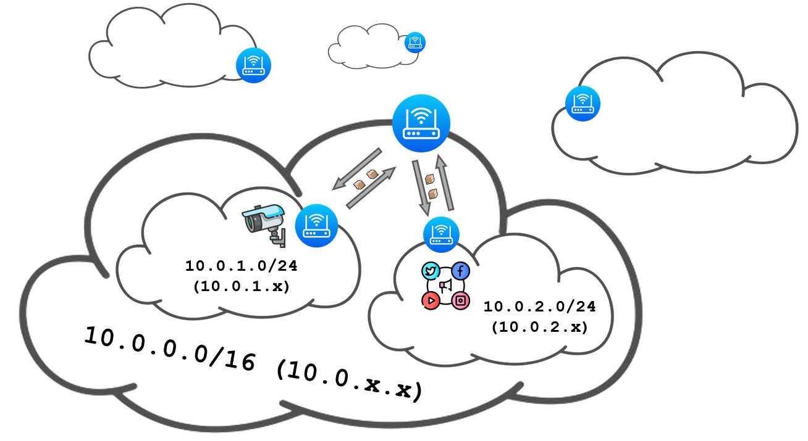
What is a subnet?
So if we had a company where we want to divide our network into the security cameras subnet and the marketing department subnet, we could have the following setup:

Slide 40
What is a subnet?
And how do routers apply different rules to different subnets? They use route tables. It consists of a list of rules that specify which traﬀic can go where.
We could build a route table that says that traﬀic from the marketing department and security cameras can go to the internet (so we may simplify and say that traﬀic originating from any subnet can go to the internet), but traﬀic from the marketing department can’t go to the security cameras subnet and vice versa.

Slide 41
Networking in AWS

Slide 42
How do AWS networks work?
So far we have been talking about networks in general, but how do networks work in AWS? Just as a reminder, remember we are in this network of networks called the internet.

Slide 43
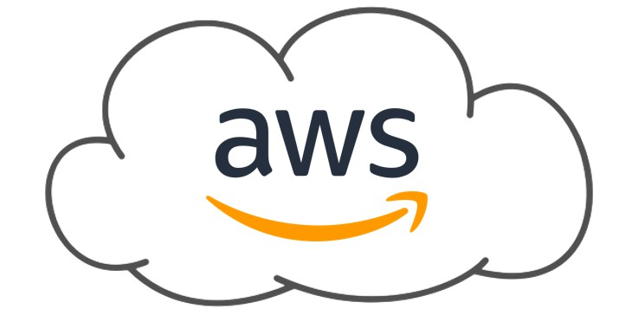
How do AWS networks work?
And of course, AWS is part of the internet.

Slide 44
How do AWS networks work?
But what happens inside the AWS network? How do different users have its own individual space?
Each user in AWS has its own set of networks. These networks are called Virtual Private Clouds (VPCs) which is just a fancy name for the AWS service that lets us create and manage our own networks inside AWS.
By default, everything we launch in AWS lives inside the same VPC, which is one that AWS creates and configures for us. But we can create other VPCs and configure them as we want.

Slide 45
Lab: Experimenting with VPCs

Slide 46
Goal of the lab
During this lab we will:
Create a VPC.
Create two subnets in the VPC.
Configure one subnet as public and the other as private with an Internet Gateway and Route Tables.
Deploy an EC2 instance in both subnets.
Access the private EC2 instance from the public EC2 instance.

Slide 47
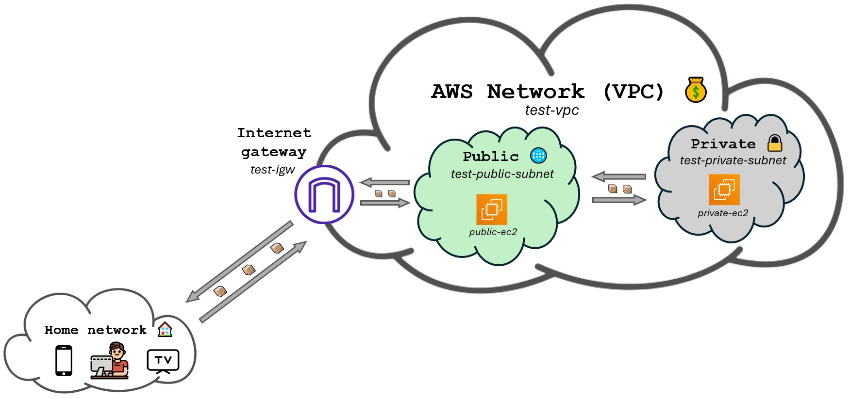
Goal of the lab

Slide 48
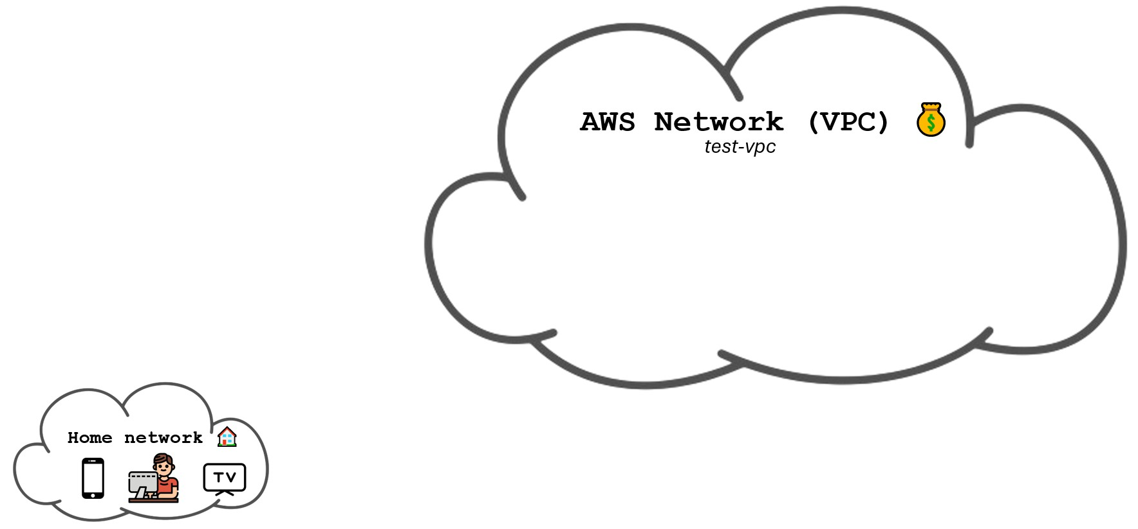
Creating a VPC

Slide 49
Creating a VPC
Go to the VPC service.
Click on Create VPC.
Choose VPC only.
Fill the form with the following settings:
Name tag: test-vpc
IPv4 CIDR block: 10.0.0.0/16
Leave the rest as default and click on Create VPC.

Slide 50
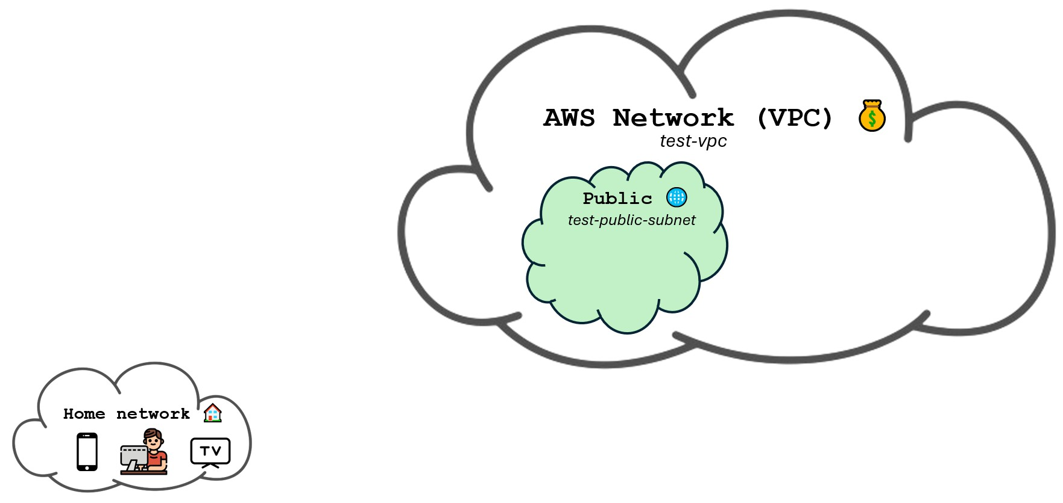
We are now going to add a subnet to the VPC we just created.
Creating a public subnet in a VPC

Slide 51
Creating a public subnet in a VPC
Navigate to the VPC service in the AWS Management Console.
Select Subnets on the left navigation pane.
Click on Create subnet.
Select the VPC you created, which is the one ending with (test-vpc).
Fill in the form with the following settings:
Name: test-public-subnet
Availability Zone: Select us-east-1a zone (or any other zone but be consistent)
IPv4 VPC CIDR block: 10.0.0.0/16 (leave as default)
IPv4 subnet CIDR block: 10.0.1.0/24
Click on Create subnet.

Slide 52
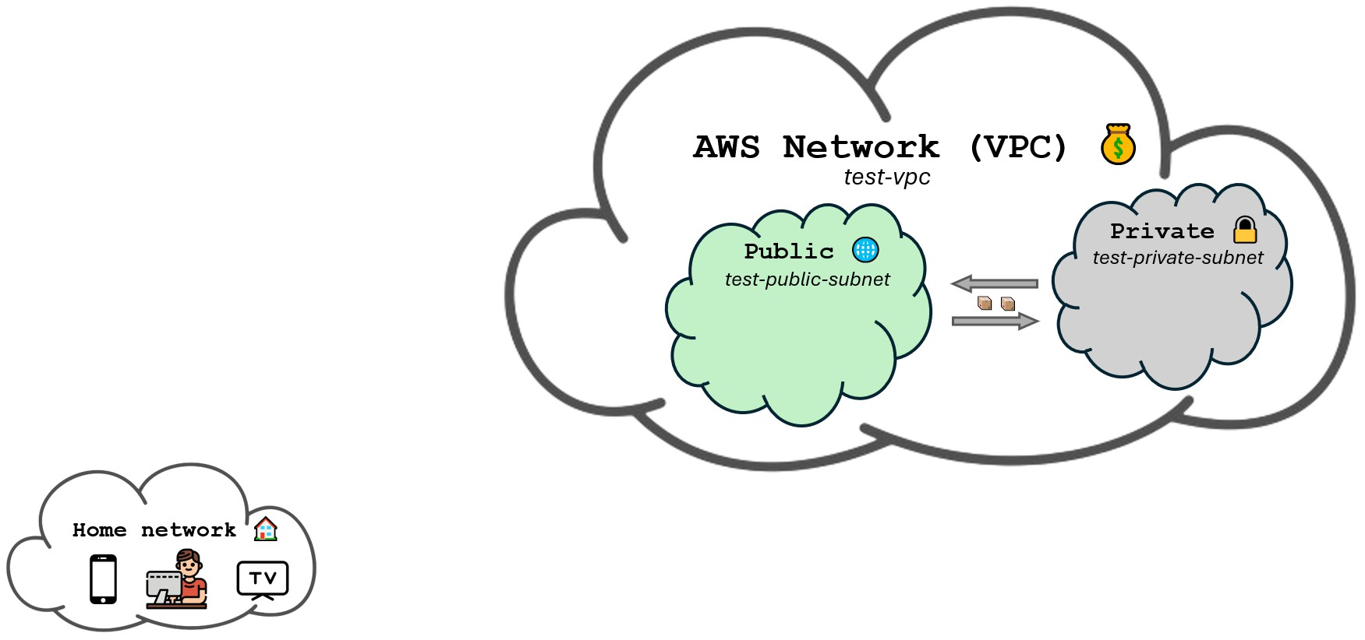
Creating a private subnet in a VPC
And we add a second one.

Slide 53
Creating a private subnet in a VPC
Navigate to the VPC service in the AWS Management Console.
Select Subnets on the left navigation pane.
Click on Create subnet.
Select the VPC you created, which is the one ending with (test-vpc).
Fill in the form with the following settings:
Name: test-private-subnet
Availability Zone: Select us-east-1a zone (the same as the public subnet)
IPv4 VPC CIDR block: 10.0.0.0/16 (leave as default)
IPv4 subnet CIDR block: 10.0.2.0/24
Click on Create subnet.

Slide 54
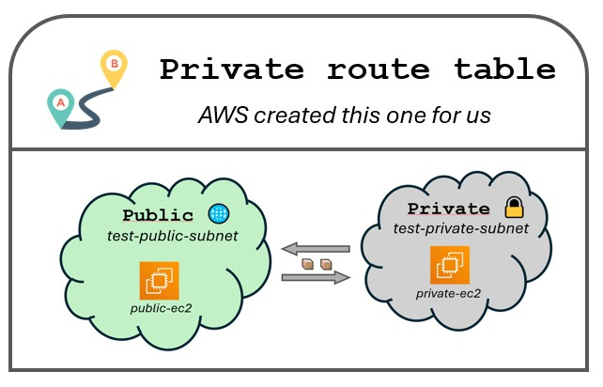
Default route table
Have you noticed the two subnets are connected? This means that the EC2 instances in the public subnet can talk to the EC2 instances in the private subnet. This is because they are part of the same VPC and the default route table allows traﬀic to flow between them.

Slide 55
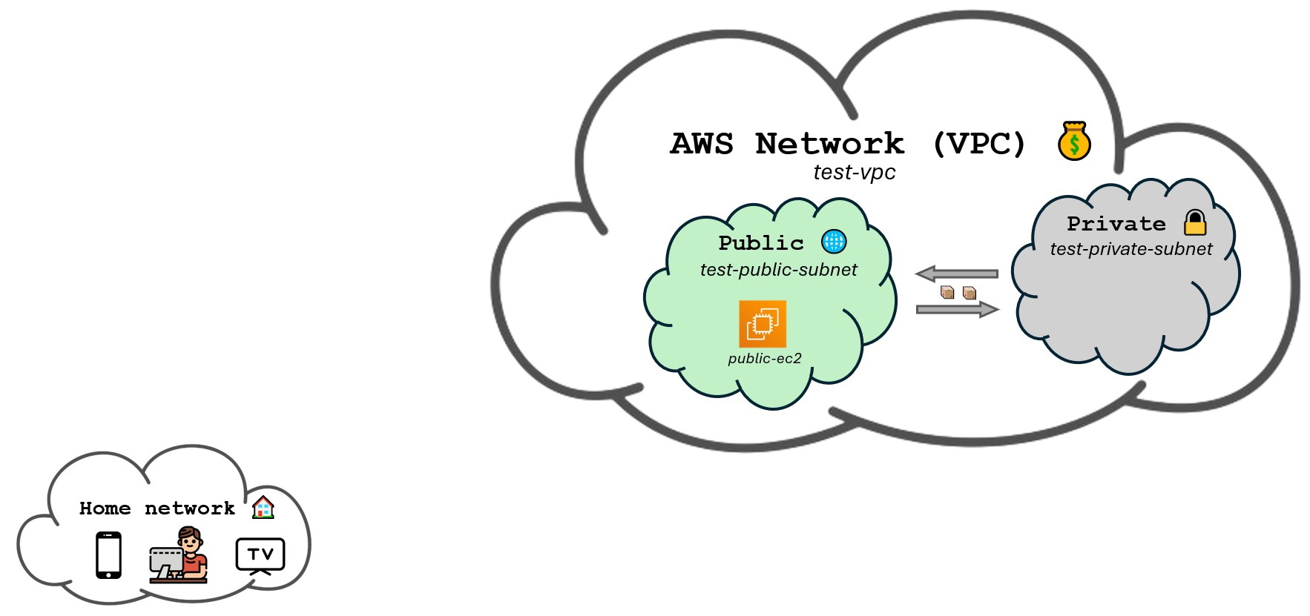
Deploying an EC2 instance in the public subnet
Now we are going to launch an EC2 instance inside the public subnet.

Slide 56
Deploying an EC2 instance in the public subnet
Go to the EC2 service.
Click on Launch instance.
Fill the form with the following settings:
Name: public-ec2
Key pair (login): Choose aws-keypair (the one we have already been using)
In the network settings tab clik on Edit and select the following settings:
VPC - required: The one ending with (test-vpc)
Subnet: test-public-subnet
Auto-assign Public IP: Enable
Leave the rest as default and click on Launch instance.

Slide 57
Accessing the public EC2 instance
Try to access the public EC2 instance using the following command:
$ ssh -i ~/.ssh/aws-keypair ec2-user@<your-public-ec2-instance-public-ip>
You’ll notice that the command hangs for a while and finally fails with a timeout error. Which means the EC2 instance didn’t respond.

Slide 58
Accessing the public EC2 instance
Observations
The EC2 instance is not accessible from the internet.
The reason is because the VPC and the subnet are private by default.
Although we named one subnet as public, it is not public yet.
Solution
We need to create an internet gateway and a routing table.
The internet gateway will be the entrypoint for the internet traﬀic to the VPC.
The routing table will make internet traﬀic able to go from the internet gateway to a given subnet.
Once the traﬀic can reach a subnet, it can reach the EC2 instances on that subnet.
Doing this with an internet gateway means that the traﬀic is bidirectional. The EC2 instances can also reach the internet.

Slide 59
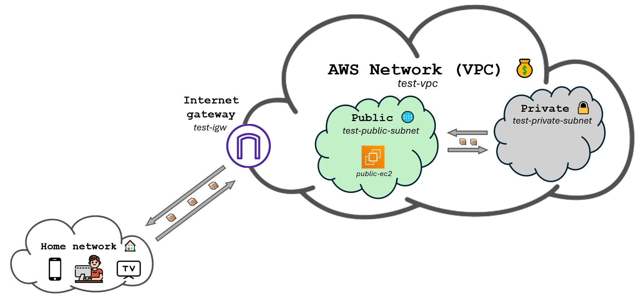
Accessing the public EC2 instance
To access the public instance, we’ll first need to allow traﬀic to get to the VPC. We’ll do this by creating an Internet Gateway.

Slide 60
Accessing the public EC2 instance
Creating an Internet Gateway
Go to the VPC service.
Click on Internet Gateways on the left navigation pane.
Click on Create internet gateway.
Fill the form with the following settings:
Name: test-igw
Click on Create internet gateway.
Now click on Actions on the top right corner and select Attach to VPC.
Choose the one ending with test-vpc and click on Attach internet gateway.

Slide 61
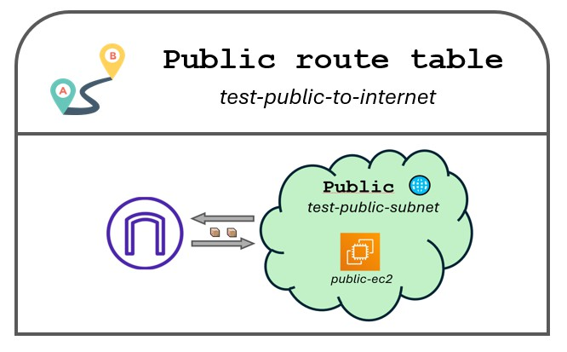
Accessing the public EC2 instance
Now traﬀic is getting to the VPC, but it still can’t reach devices inside the public subnet. That is because despite its name, the public subnet is still private. We need to make it public by creating a Route Table.

Slide 62
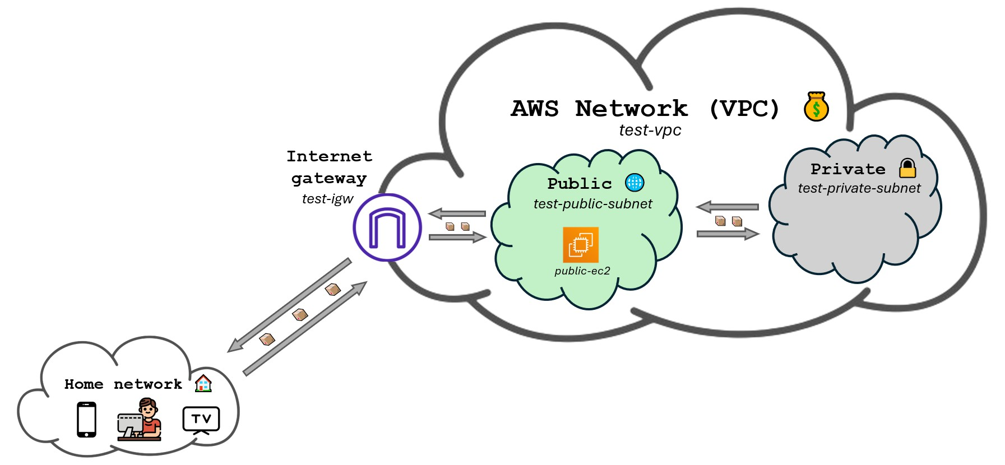
Accessing the public EC2 instance
Once the table is created, traﬀic will be able to reach the public subnet.

Slide 63
Accessing the public EC2 instance
Creating a Route Table
Go to the VPC service.
Click on Route Tables on the left navigation pane.
Click on Create route table.
Fill the form with the following settings:
Name: test-public-to-internet
VPC: The one ending with (test-vpc)
Click on Create route table.
Click on Actions on the top right corner and select Edit subnet associations.
Choose the public subnet and click on Save associations.
Click on Actions on the top right corner and select Edit routes.
Click on Add route and fill the form with the following settings:
Destination: 0.0.0.0/0
Target: Choose Internet Gateway and select the one ending with (test-igw).
Click on Save changes.

Slide 64
Accessing the public EC2 instance
Now the EC2 instance is accessible from the internet.
The public subnet is indeed public now.
The private subnet is still private.

Slide 65
Deploying an EC2 instance in the private subnet
We are now going to launch an EC2 instance inside the private subnet.

Slide 66
Deploying an EC2 instance in the private subnet
Go to the EC2 service.
Click on Launch instance.
Fill the form with the following settings:
Name: private-ec2
Key pair (login): Choose aws-keypair (the one we have already been using)
In the network settings tab clik on Edit and select the following settings:
VPC - required: The one ending with (test-vpc)
Subnet: test-private-subnet
Auto-assign Public IP: Enable
Leave the rest as default and click on Launch instance.

Slide 67
Accessing the private EC2 instance
We know we are not going to be able to SSH into the private EC2 instance since it resides in a private subnet. What we aim to do is to access the private EC2 instance from the public EC2 instance.
The first step is going to be to copy our private key onto the public EC2 instance so we can SSH into the private EC2 instance from there. Open a terminal in your local machine and run the following command:
$ scp -i ~/.ssh/aws-keypair ~/.ssh/aws-keypair ec2-user@<your-public-ec2-instance-public-ip>:.ssh/
This is just copying the private key to the public EC2 instance. Now we can SSH into the public EC2 instance and from there try to SSH into the private EC2 instance.

Slide 68
Accessing the private EC2 instance
SSH into the public EC2 instance using the following command:
$ ssh -i ~/.ssh/aws-keypair ec2-user@<your-public-ec2-instance-public-ip>
And run the following command to change the permissions of the private key:
[ec2-public]$ chmod 600 ~/.ssh/aws-keypair
Test internet access from the private EC2 instance by running the following command:
[ec2-private]$ ping google.com
From the public EC2 instance, try SSH into the private EC2 instance using the following command:
[ec2-public]$ ssh -i ~/.ssh/aws-keypair ec2-user@<your-private-ec2-instance-public-ip>
Usually, the private EC2 instance has no public IP address.

Slide 69
Accessing the private EC2 instance
You’ll notice that the command hangs for a while and finally fails with a timeout error just as id did earlier when the public EC2 instance was not accessible from the internet. This is because we are trying to access the private EC2 instance using its public IP address. We need to use the private IP address instead.
Go to the EC2 service in the AWS Management Console and copy the private IP address of the private EC2 instance. Then SSH into the public EC2 instance and try to SSH into the private EC2 instance using the private IP address.
[ec2-private]$ ssh -i ~/.ssh/aws-keypair ec2-user@<your-private-ec2-instance-private-ip>
Test internet access from the private EC2 instance by running the following command:
[ec2-private]$ ping google.com
It should error out, signaling that there is no internet access.

Slide 70
Accessing the private EC2 instance
Observations
The EC2 instance is not accessible from the internet and will never be.
We can access the private EC2 instance from the public EC2 instance.
The private instance doesn’t have access to the internet.

Slide 71
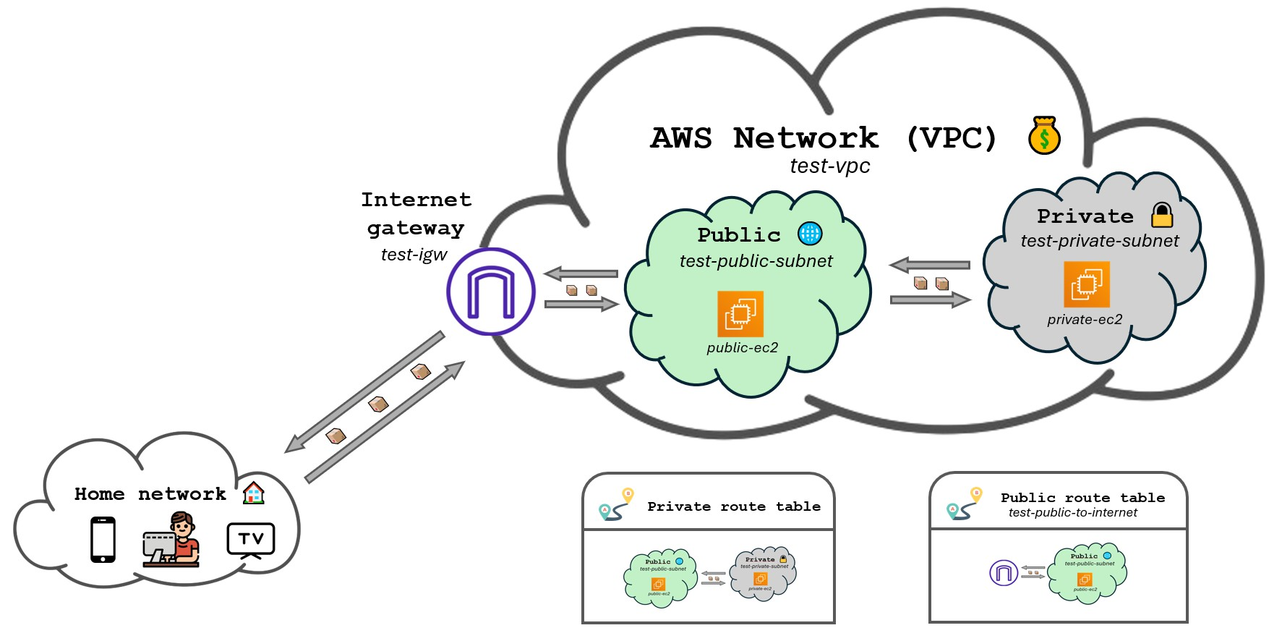
Recap
We ended up with this setup.

Slide 72
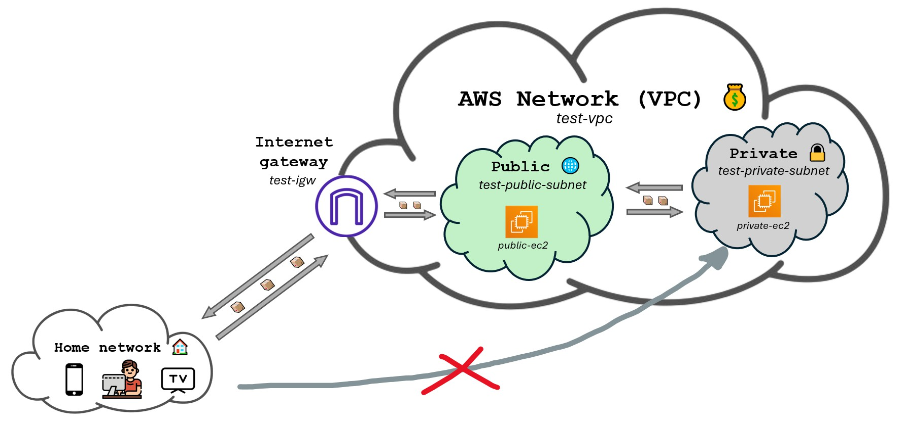
Where we can’t directly access the private EC2 instance through SSH.
Recap

Slide 73
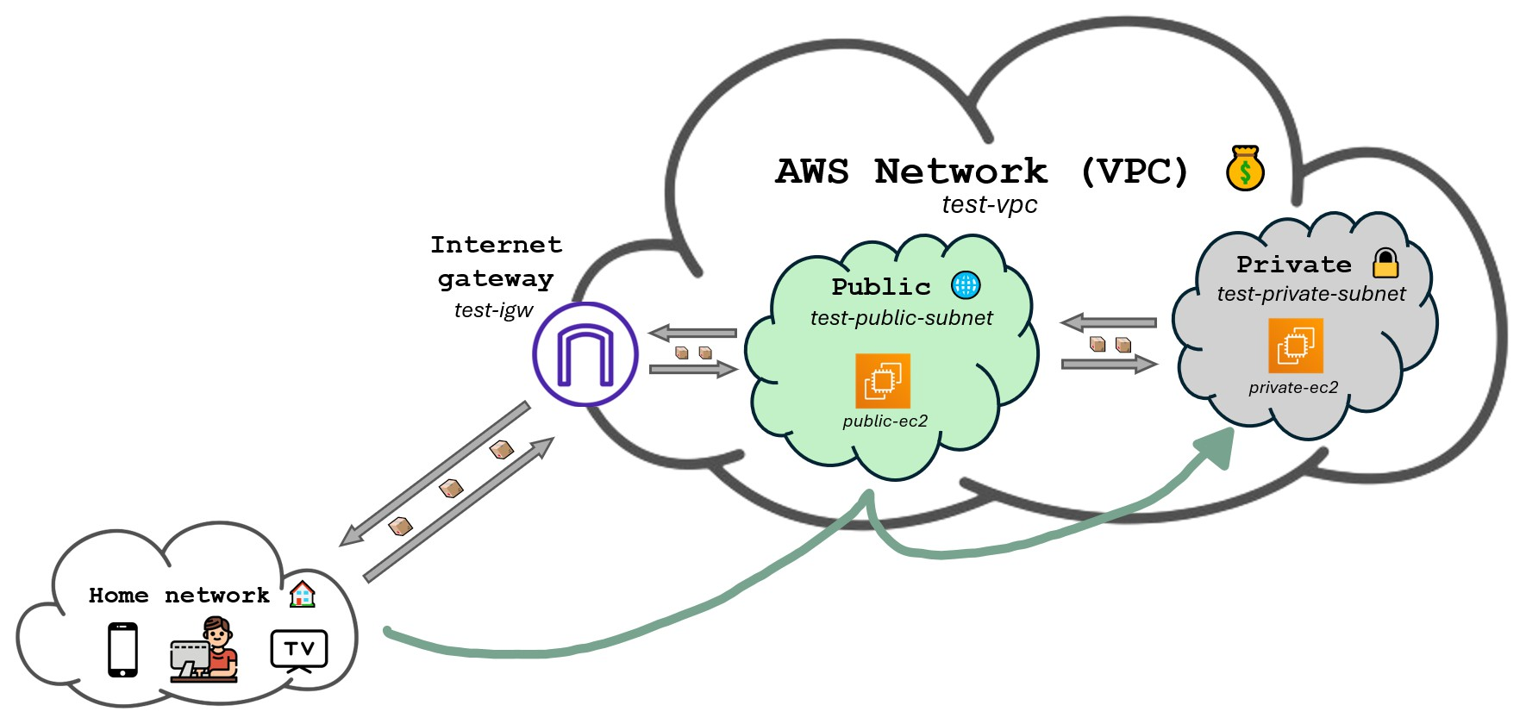
But we can access the private EC2 instance from the public EC2 instance.
Recap

Slide 74
VPNs

Slide 75
What is a VPN?
A Virtual Private Network (VPN) is a secure connection between two networks over the internet. They allow devices to behave like they are on a network they are not physically connected to.
VPNs encrypt traﬀic, making communication secure.
They enable private resources to be accessed remotely as if directly connected to the private network.
We use VPNs mainly for:
Privacy: Mask the source IP address.
Remote Access: Connect securely to resources inside a private network from anywhere.

Slide 76
What is a VPN?
Think of a VPN as a tunnel connecting two buildings. The tunnel would allow me to access private resources on the other building as if I were inside it.
If I wanted to send a package from my home but no one to know it was sent from my home, I could send through the tunnel first and then from the other building to the destination. The package would be sent from the other building, not from my home.
Users inside the tunnel communicate as if they were in the same location.

Slide 77
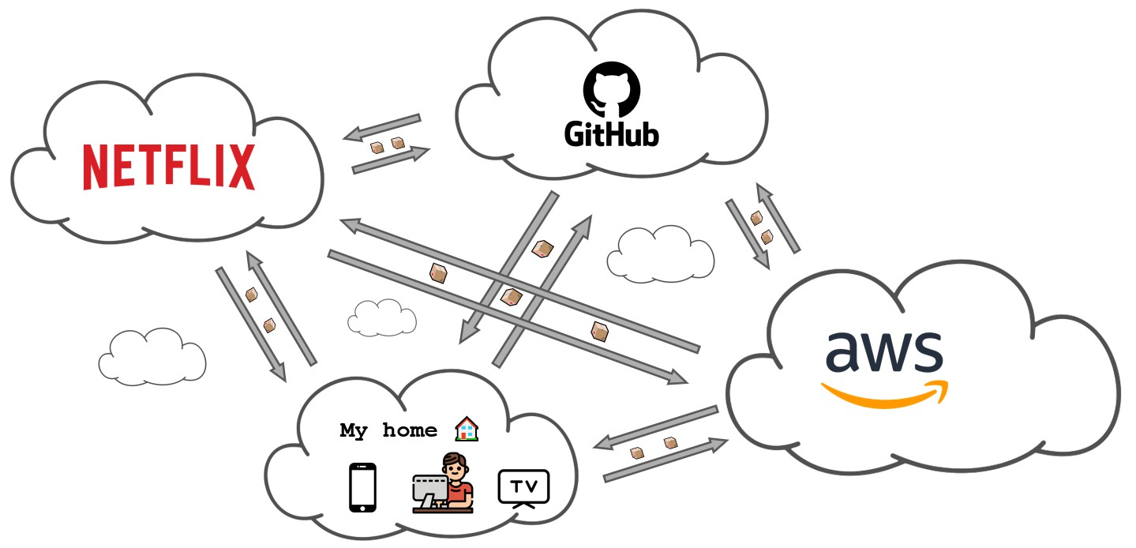
What is a VPN?

Slide 78
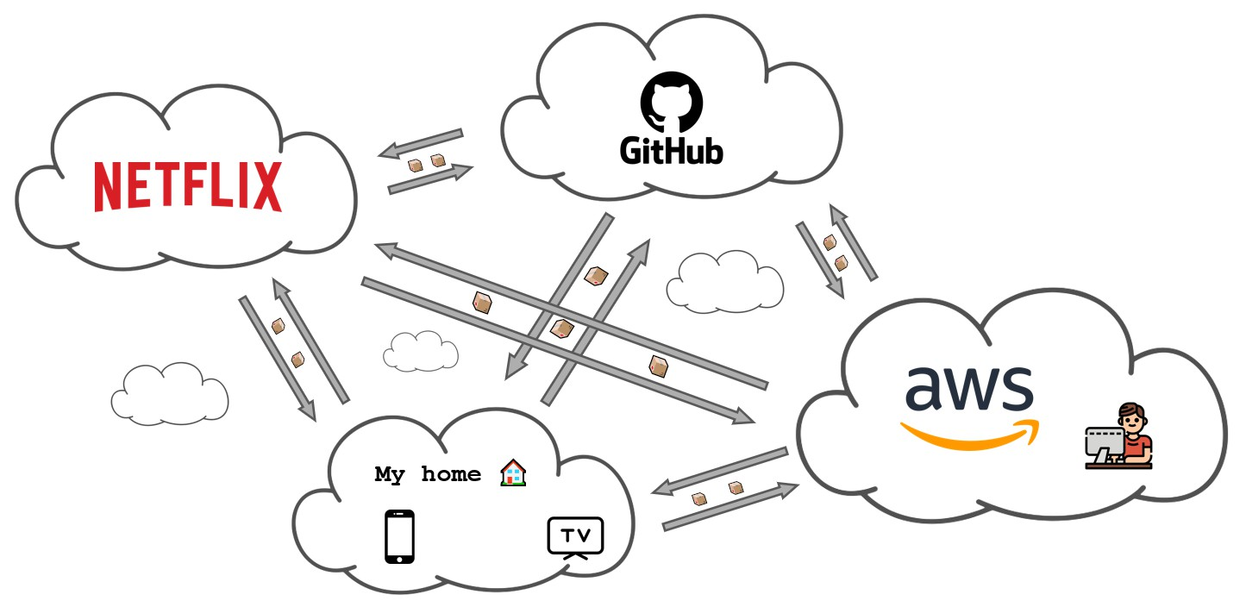
What is a VPN?

Slide 79
Lab: Building our own VPN

Slide 80
Goal of the lab
During this lab we will:
Create a VPN using the AWS Client VPN service.
Connect to the VPN from our computer.
Deploy a file server on a private EC2 instance.
Access the file server from our computer through the VPN.

Slide 81
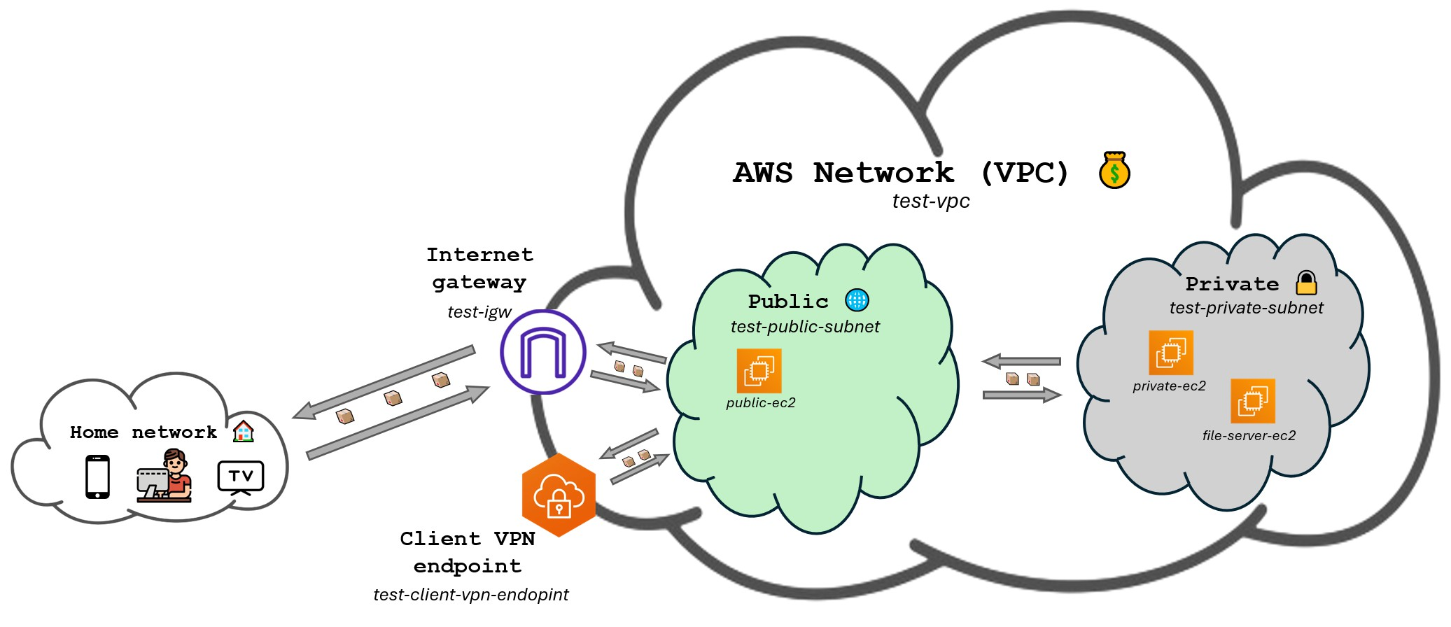
Goal of the lab

Slide 82
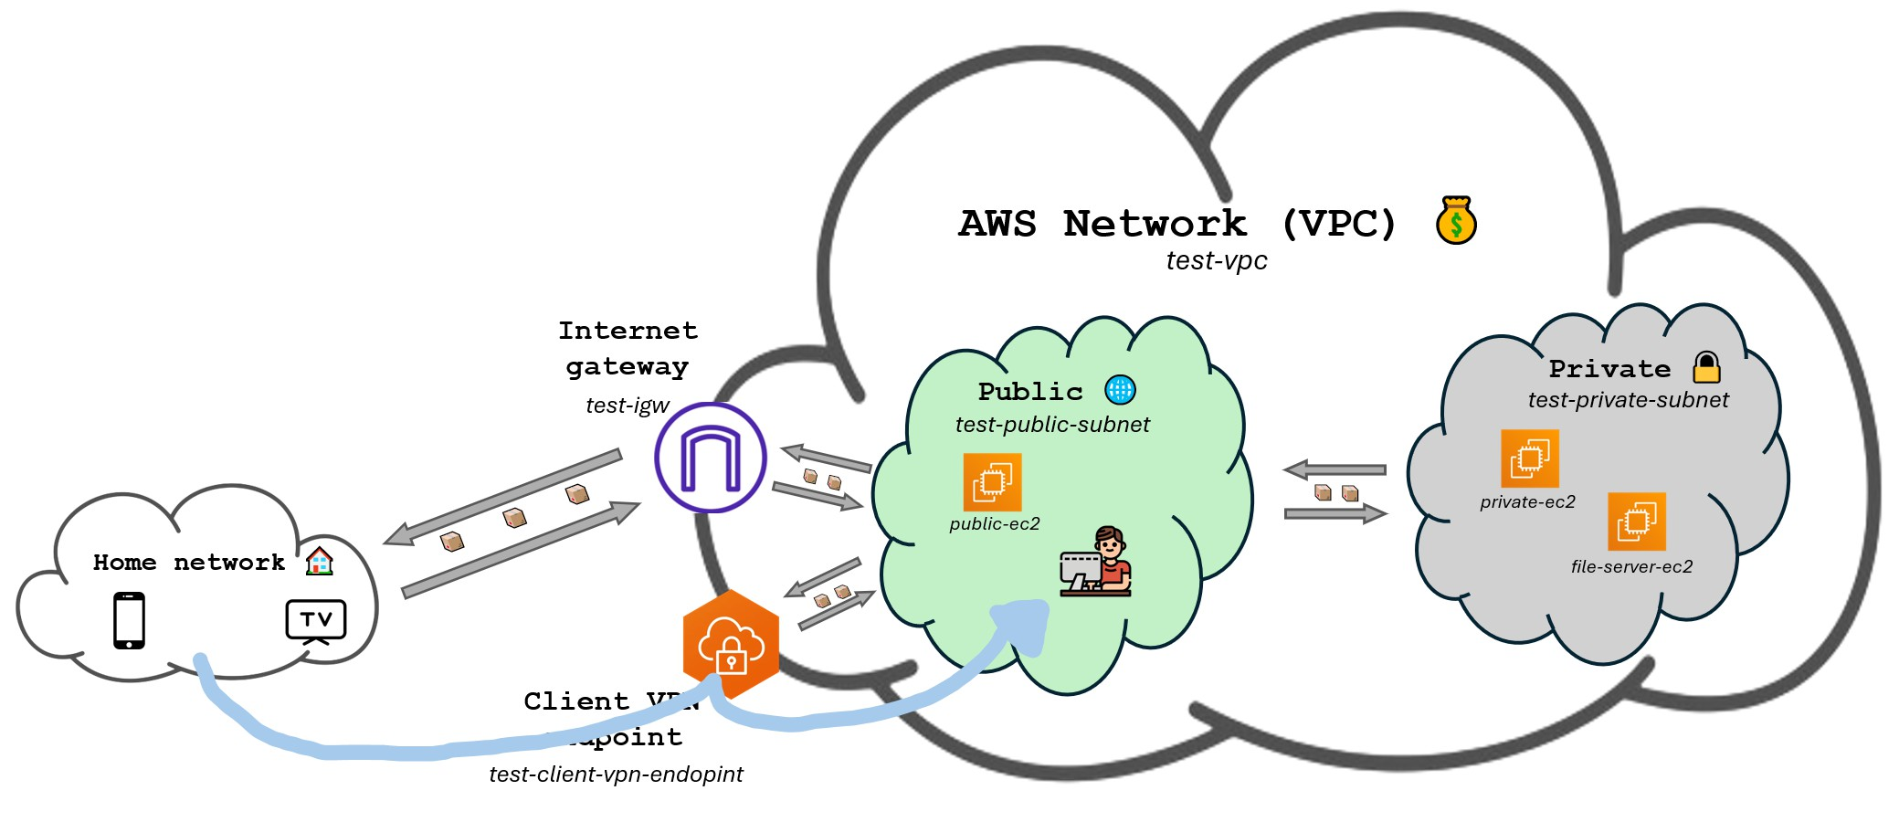
Goal of the lab

Slide 83
Generate client and server certificates
First of all we need to generate the certificates for the VPN. We will use EasyRSA to generate them.
For Windows users:
Visit https://github.com/OpenVPN/easy-rsa/releases and look for a file in Assets ending with
win64.zip.
Download the file and extract it.
Open a terminal and navigate to the folder where you extracted the files.
Run the following command: .\EasyRSA-Start.bat
For MacOS and Linux users:
$ git clone https://github.com/OpenVPN/easy-rsa.git
$ cd easy-rsa/easyrsa3

Slide 84
Generate client and server certificates
Now that we have EasyRSA running, we can generate the certificates.
$ ./easyrsa init-pki
$ ./easyrsa build-ca nopass
When the following is shown in the terminal just press enter:
Common Name (eg: your user, host, or server name) [Easy-RSA CA]:

Slide 85
Generate client and server certificates
Now run the commands below:
$ ./easyrsa --san=DNS:server build-server-full server nopass
$ ./easyrsa build-client-full client1.domain.tld nopass
In both commands, when you see the text below, just type yes and hit enter:
Type the word 'yes' to continue, or any other input to abort. Confirm requested details: yes

Slide 86
Generate client and server certificates
Okay so we’ve now successfully generated the certificates. We just need to move them to another folder to make it easier to work with them.
Windows users type exit and then run the following commands (instructions for MacOS/Linux are on the next slide):
mkdir C:\custom_folder
copy pki\ca.crt C:\custom_folder
copy pki\issued\server.crt C:\custom_folder copy pki\private\server.key C:\custom_folder
copy pki\issued\client1.domain.tld.crt C:\custom_folder copy pki\private\client1.domain.tld.key C:\custom_folder cd C:\custom_folder

Slide 87
Generate client and server certificates
For those on MacOS and Linux (you don’t have to type exit):
$ cd easyrsa3
$ mkdir ~/custom_folder/
$ cp pki/ca.crt ~/custom_folder/
$ cp pki/issued/server.crt ~/custom_folder/
$ cp pki/private/server.key ~/custom_folder/
$ cp pki/issued/client1.domain.tld.crt ~/custom_folder
$ cp pki/private/client1.domain.tld.key ~/custom_folder/
$ cd ~/custom_folder/

Slide 88
Import the certificates to AWS
Now we just need to import the certificates to AWS. We’ll do that with the AWS CLI, so remember to update your .aws/credentials file with your access key and secret key.
$ aws acm import-certificate --certificate fileb://server.crt \
--private-key fileb://server.key \
--certificate-chain fileb://ca.crt --region us-east-1
$ aws acm import-certificate --certificate fileb://client1.domain.tld.crt \
--private-key fileb://client1.domain.tld.key \
--certificate-chain fileb://ca.crt --region us-east-1

Slide 89
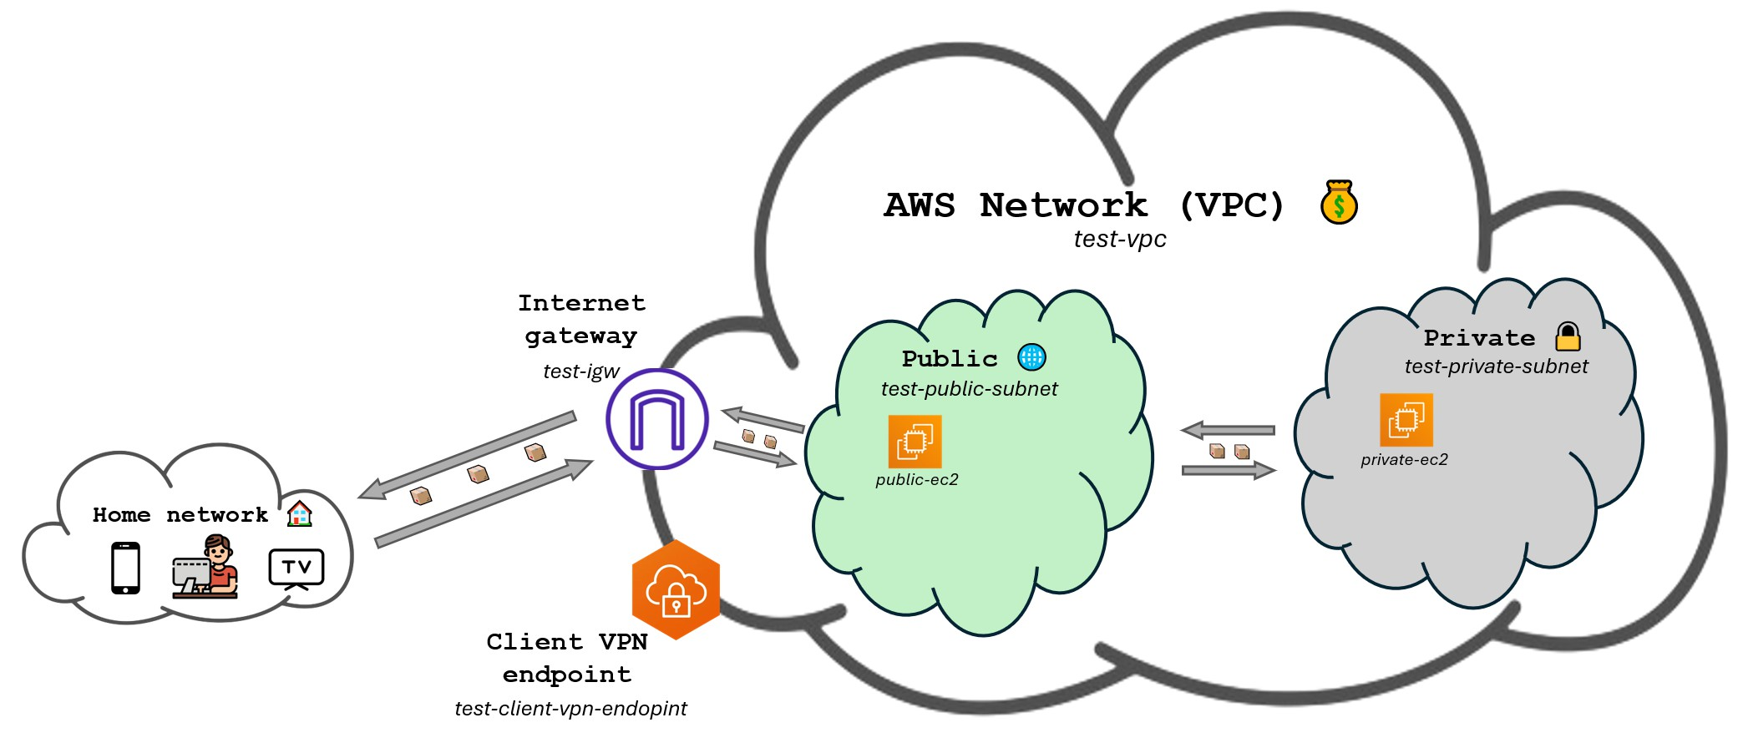
Create client VPN endpoint

Slide 90
Create client VPN endpoint
Now we are going to create the client VPN endpoint.
Search for Client VPN endpoints in the AWS Management Console and click on the first result.
Click on Create Client VPN endpoint.
Fill the form with the following
Name tag: test-client-vpn-endpoint
VPC ID: The one ending with (test-vpc)
Mark only IPv4 addresses 2 times
Client IPv4 CIDR: 10.83.0.0/16
Server certificate ARN: Look for the one called server .
Authentication options: Enable Mutual authentication and select the client certificate called
client1.domain.tld .
DNS server 1 IP address: 1.1.1.1
DNS server 2 IP address: 8.8.8.8
Leave the rest as default and click on Create Client VPN endpoint.

Slide 91
Associate the client VPN endpoint with the VPC public subnet
Now we need to associate the client VPN endpoint with the public subnet.
Click on the client VPN endpoint we just created or search for Client VPN endpoints in the AWS Management Console if you are not there.
Click on the Target network associations tab down below.
Click on Associate target network.
Choose test-public-subnet for the subnet.
Click on Associate target network.

Slide 92

Add an authorization rule for the VPC

Slide 93
Add an authorization rule for the VPC
Now we are going to add an authorization rule to allow traﬀic to flow from the VPN to the VPC.
Click on the Authorization rules tab.
Click on Add authorization rule.
Enter 10.0.0.0/16 for the destination network and click on Add authorization rule.

Slide 94
Provide access to the internet for devices connected to the VPN
We would now be able to connect to the VPN, but once connected to the VPN we would not have acces to the internet. That is because we have to add a route to the route table and an authorization rule allow traﬀic to the internet.
Click on the Route table tab.
Click on Create route.
Fill the form with the following
Route destination: 0.0.0.0/0
Subnet ID for target network association: Choose the onte starting with subnet
Click on Create route.
Click on the Authorization rules tab.
Click on Add authorization rule.
Choose 0.0.0.0/0 for Destination network to enable access and click on Add authorization rule.

Slide 95
Setup the Client VPN endpoint configuration file
Now we are going to setup the configuration file for the VPN. This file is the one we are going to use on our computer to connect to the VPN.
Search for Client VPN endpoints in the AWS Management Console if you are not there and click on the client VPN endpoint we created.
You’ll now be able to click on Download client configuration.
This will download a file called downloaded-client-config.ovpn.
Open the file with a text editor since we’re going to modify it.

Slide 96
Setup the Client VPN endpoint configuration file
We are going to use those certificate files we created earlier, so we would need a terminal on the folder we moved the certificates to. Follow the steps below if you closed the terminal we used before.
Windows users:
cd C:\custom_folder
MacOS/Linux users:
cd ~/custom_folder/

Slide 97
Setup the Client VPN endpoint configuration file
With the downloaded-client-config.ovpn file open in a text editor, add the following lines at the beginning of the file:
<cert>
Contents of client certificate (.crt) file
</cert>
<key>
Contents of private key (.key) file
</key>

Slide 98
Setup the Client VPN endpoint configuration file
Now replace the Contents of client certificate (.crt) file with the content of the client1.domain.tld.crt file and the Contents of private key (.key) file with the content of the client1.domain.tld.key file.
To obtain the contents of those files you can run the following commands on the terminal we have opened:
$ cat client1.domain.tld.crt
$ cat client1.domain.tld.key
Once you are done, save the downloaded-client-config.ovpn file.

Slide 99
Connect to the Client VPN endpoint
We have everything ready to connect to the VPN, we just need to download the AWS VPN Client which can be obtained here https://aws.amazon.com/vpn/client-vpn-download/.
Once you have installed the client, open it, click on File > Manage Profiles > Add Profile, type whichever name you want for Display name and for VPN Configuration file click on the browse icon and select the downloaded-client-config.ovpn file we just modified.
Then type connect to the VPN.

Slide 100
Test the VPN
Now that we are connected to the VPN, we can test do a couple tests.
First of all, we should now be able to SSH into the private EC2 instance directly from our computer. To do this, open a terminal and run the following command:
$ ssh -i ~/.ssh/aws-keypair ec2-user@<your-private-ec2-instance-private-ip>
We are now in the private EC2!!
Another cool thing to do is to use an IP geolocation website like https://iplocation.io/ to see that your IP address is now the one of the VPN and that your location has changed.
You could also try visiting websites that are only available to people in the US. For example https://www.radio.com.

Slide 101
Deploying a file server on the private subnet
We’re now going to add another machine on the private subnet where we are going to deploy a file server (like a Google Drive).
This service is called FileGator, read more about it here https://filegator.io/. It’s basically one of many open-source locally deployable file servers.
This time we’re not going to use the Amazon Linux base image and instead we’ll use Ubuntu since it will make things easier.

Slide 102

Deploying a file server on the private subnet

Slide 103
Create an EC2 instance on the private subnet
Go to the EC2 service.
Click on Launch instance.
Fill the form with the following settings:
Name: file-server-ec2
Application and OS Images: Click on Ubuntu
Key pair (login): Choose aws-keypair (the one we have already been using)
In the network settings tab clik on Edit and select the following settings:
VPC - required: The one ending with (test-vpc)
Subnet: test-private-subnet
Auto-assign Public IP: Enable
Still inside the network settings, on the Inbound Security Group Rules section, click on the button Add security group rule and add the following rule:
Type: Custom TCP
Source type: Anywhere
Port range: 8080
Leave the rest as default and click on Launch instance.

Slide 104
Give it access to internet
If you remember, machines deployed on the private subnet dit not have access to the internet.
We’re going to temporarily enable internet access (which is not the same as making it public) so we can install the necessary software. Once we’re finished we are going to remove the internet access.
To do so, we’re going need a NAT Gateway and a new Route table for the private subnet.

Slide 105
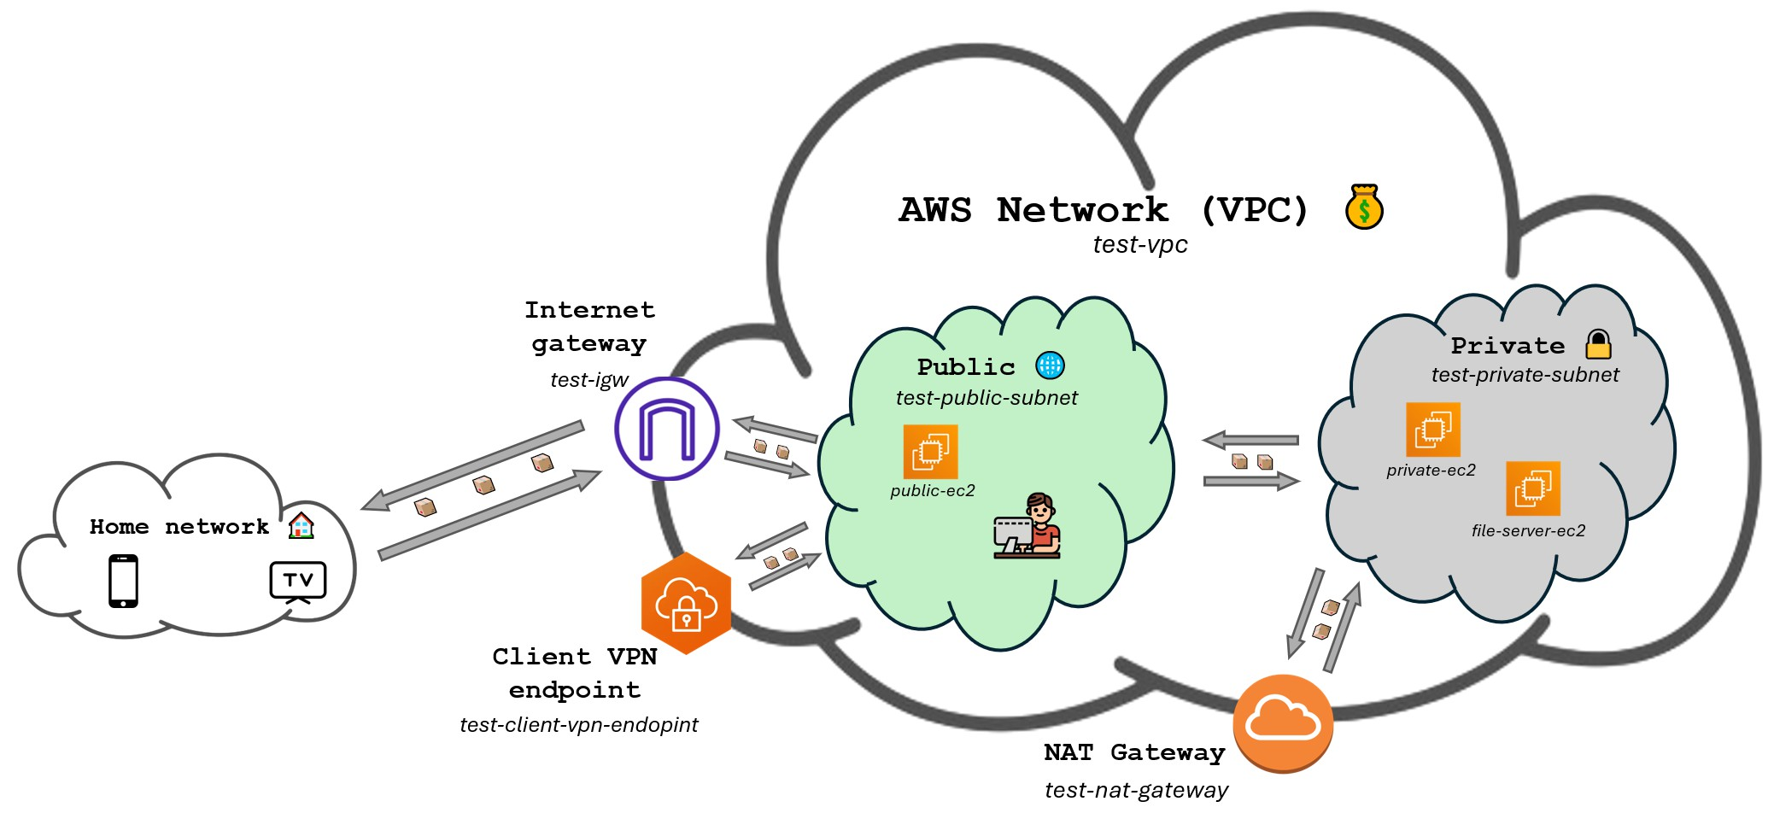
Give it access to internet

Slide 106
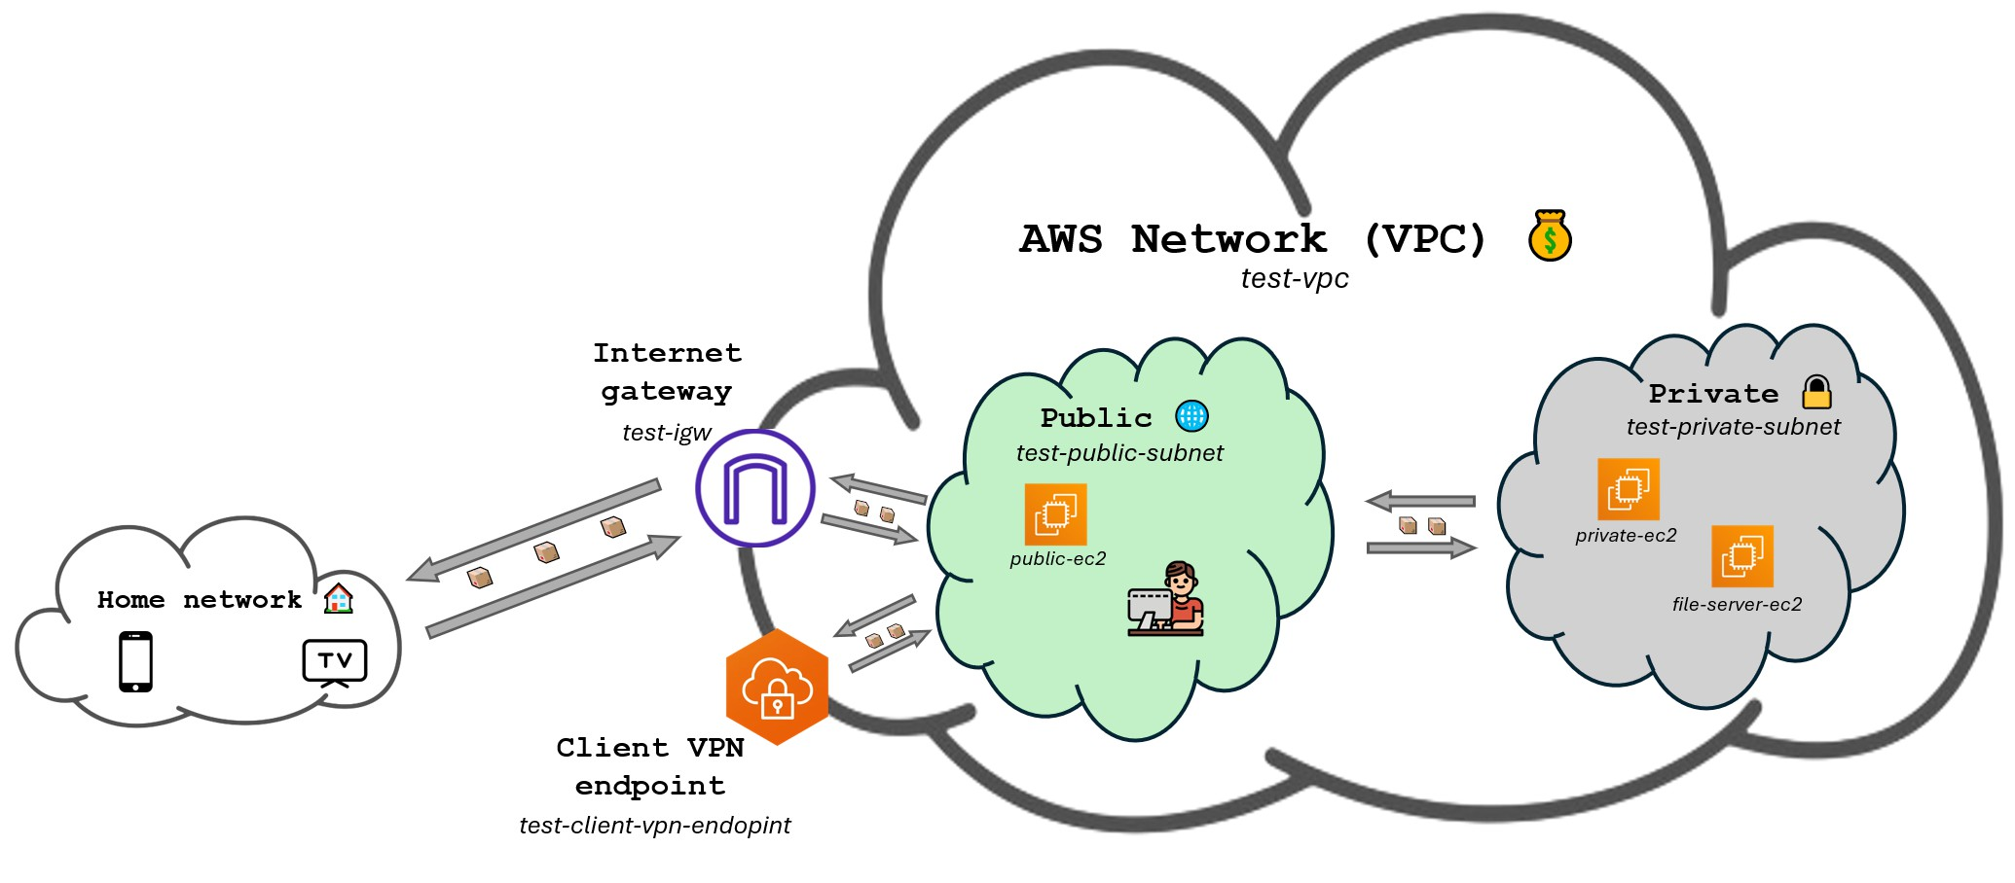
Give it access to internet

Slide 107
Give it access to internet
Follow the steps below to create the NAT Gateway:
Search for NAT Gateways in the AWS Management Console and click on the first result.
Click on Create NAT Gateway.
Fill the form with the following settings:
Name: test-nat-gateway
Subnet: Choose the one ending with (test-public-subnet)
Elastic IP allocation ID: Click on the button on the right called Allocate Elastic IP.
Click on Create NAT Gateway.

Slide 108
Give it access to internet
Next, we’ll have to modify the route table of the private subnet to allow traﬀic to flow to the internet. Remember we said AWS already created one default route table for our subnets? That is the one we are going to modify.
Search for VPC service and click on the first result.
Click on Route Tables on the left navigation pane.
Click on the default route table that is associated with test-vpc. It is the one with no name and that ends with | test-vpc on the VPC column (you may have to scroll to the right to see it).
Click on the Routes tab down below.
Click on Edit routes.
Click on Add route and type 0.0.0.0/0 for Destination and select the NAT Gateway we just created for Target ( NAT Gateway > test-nat-gateway).

Slide 109
Deploy the file server
Now that our EC2 machine has internet access, let’s connect to it and deploy the file server.
First of all, SSH into the machine using its private IP and while being connected to the VPN:
ssh -i ~/.ssh/aws-keypair ubuntu@<file-server-ec2-instance-private-ip>
Note that we are now using ubuntu for the user instead of ec2-user.

Slide 110
Deploy the file server
Now we just have to run a couple commands to install and deploy the file server.
sudo apt update -y && sudo apt install podman-docker -y mkdir data
docker run -p 8080:8080 --restart unless-stopped -d \
-v data:/var/www/filegator/repository docker.io/filegator/filegator
That’s it! You can now access the file server by going to
http://<file-server-ec2-instance-private-ip>:8080 .

Slide 111
Remove access to the internet
Since we didn’t want machines on the private subnet to have internet access, now that the file server is configured and we won’t need to download any more software, we can remove the access to the internet.
This would be as easy as removing the route we added to the route table. But for the sake of reducing costs we’re also going to delete the NAT Gateway.

Slide 112
Remove access to the internet
To delete the route we added to the route table:
Search for VPC service and click on the first result.
Click on Route Tables on the left navigation pane.
Click on the default route table that is associated with test-vpc (the one with no name we modified before).
Click on the Routes tab down below.
Click on Edit routes.
Click on Remove on the right of the route we added.
Click on Save changes.

Slide 113
Remove access to the internet
To delete the NAT Gateway:
Search for NAT Gateways in the AWS Management Console and click on the first result.
Click on the NAT Gateway we created.
Click on Actions and then on Delete NAT Gateway.
Type delete and click on Delete.

Slide 114
Recap
During this lab we have:
Created a VPN using the AWS Client VPN service.
Connected to the VPN from our computer.
Deployed a file server on a private EC2 instance by temporarily giving it access to the internet.
Accessed the file server from our computer through the VPN.
Lots of companies use VPNs to allow their employees to access resources inside the company network from anywhere in the world. A practice which was accelerated by pandemic and the remote work it brought.
Try experimenting with being and not being connected to the VPN. Make sure the scenario we’ve setup makes sense.

